Slide 1
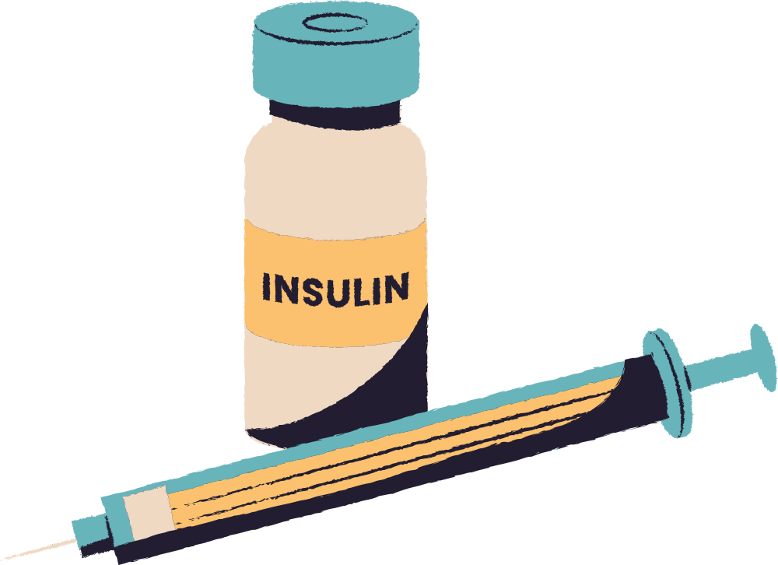

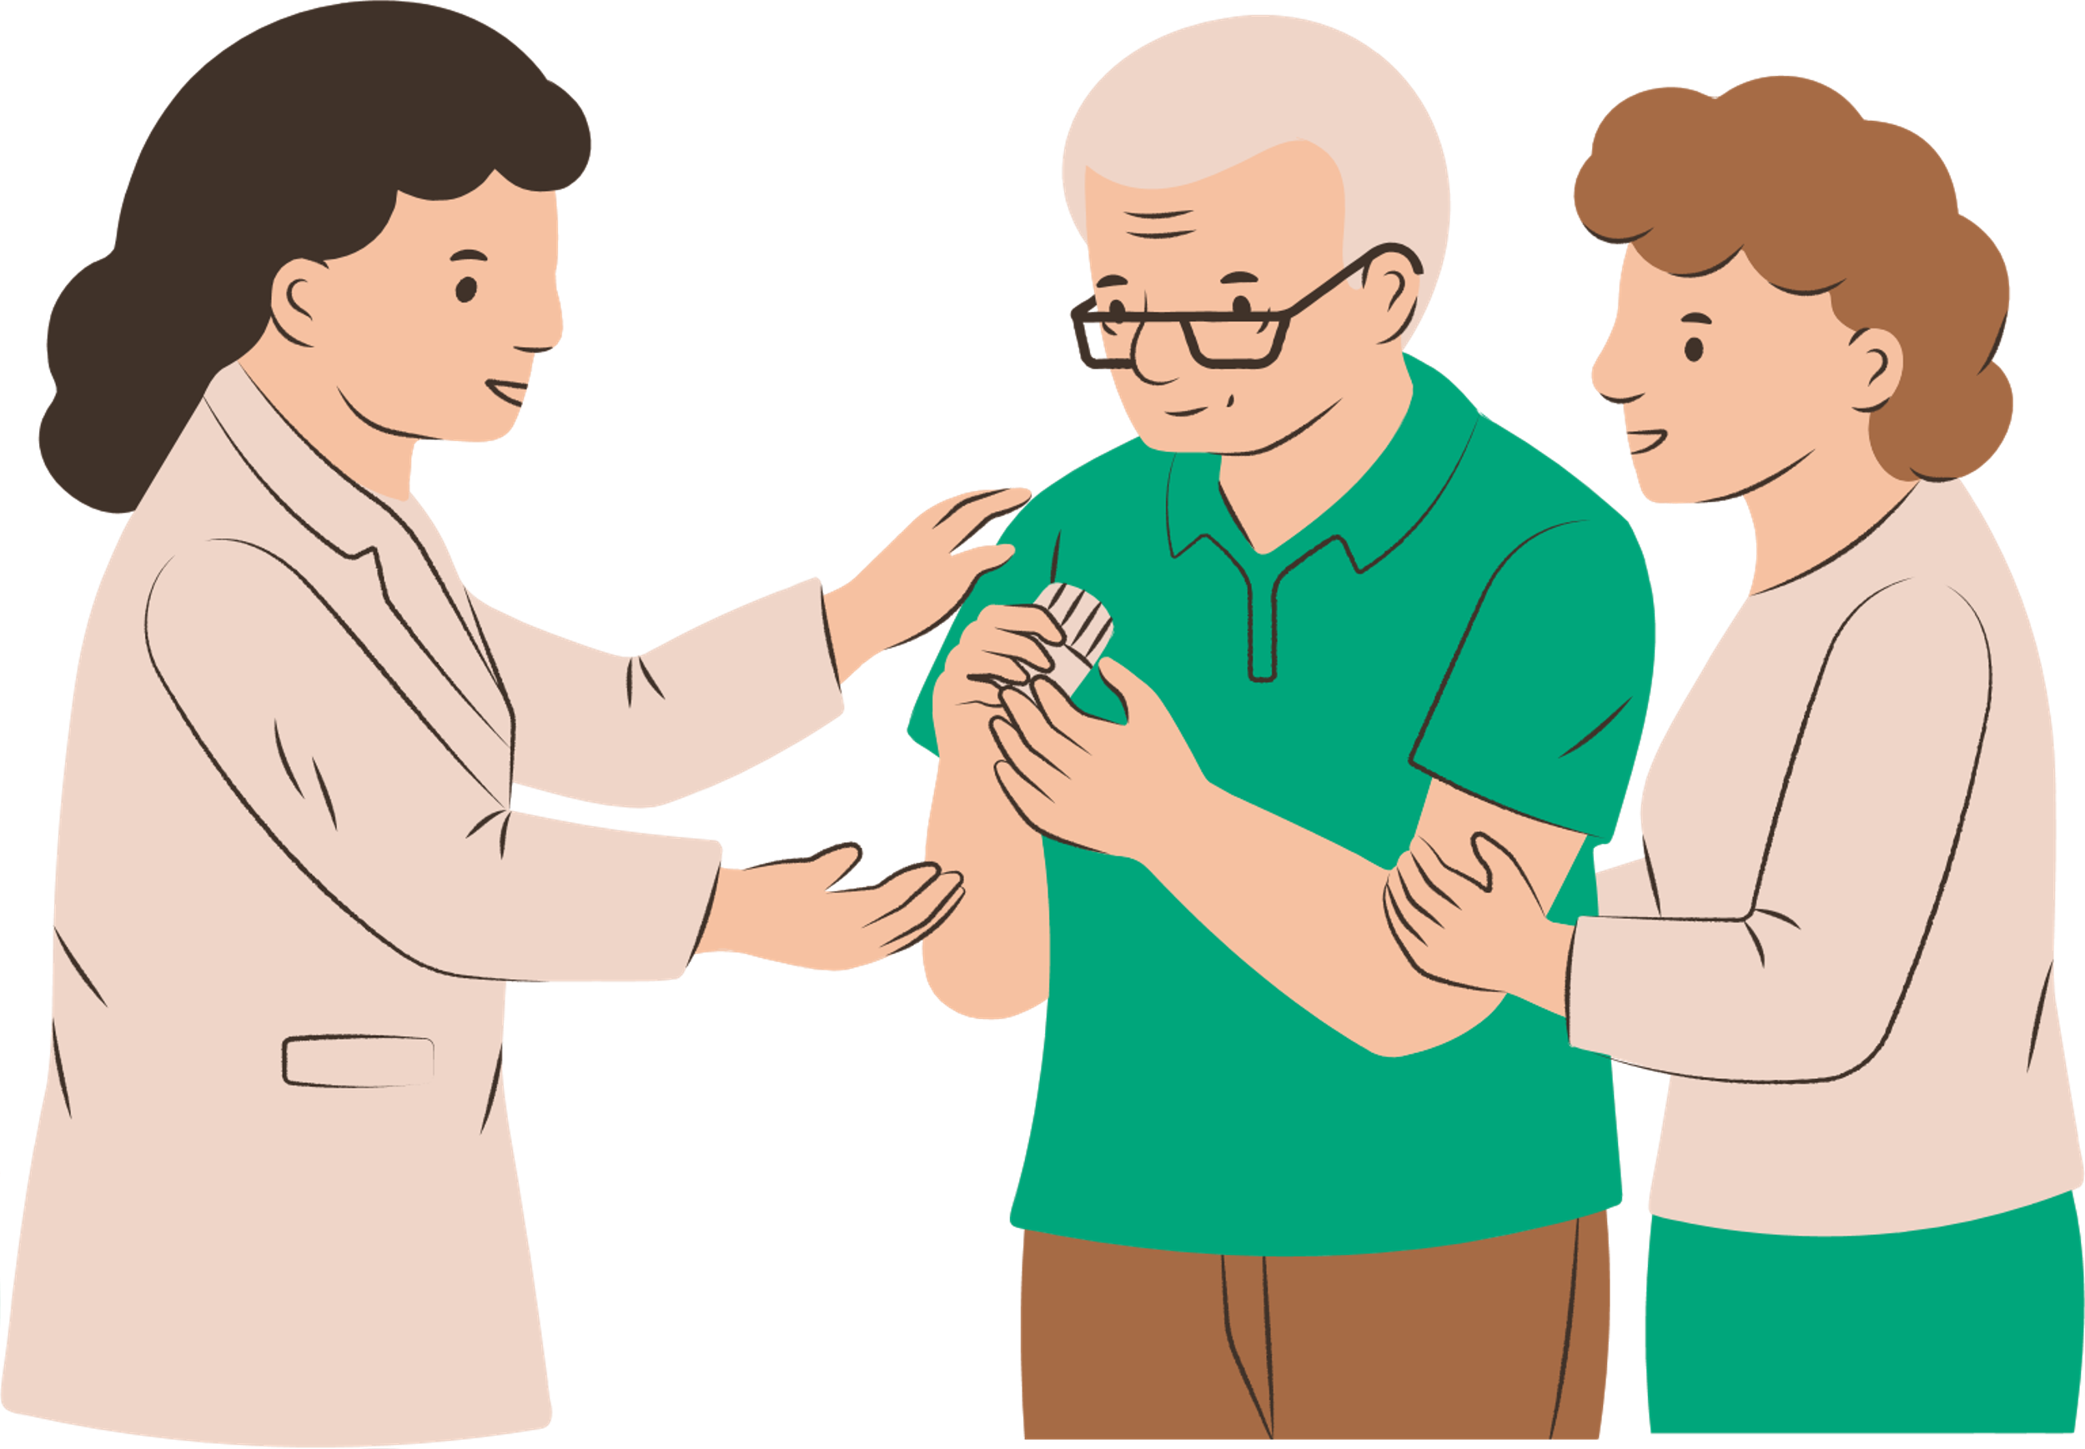
PREDICTIVE ANALYTICS FOR DIABETES
Presented by Group 7
Satya Nikitha Pulapa, Sean Kho, Kuwabara Tsusha, Liew Jun Hao, Sahoo Sidharth Sankar, Dhruv Punjabi

Slide 2
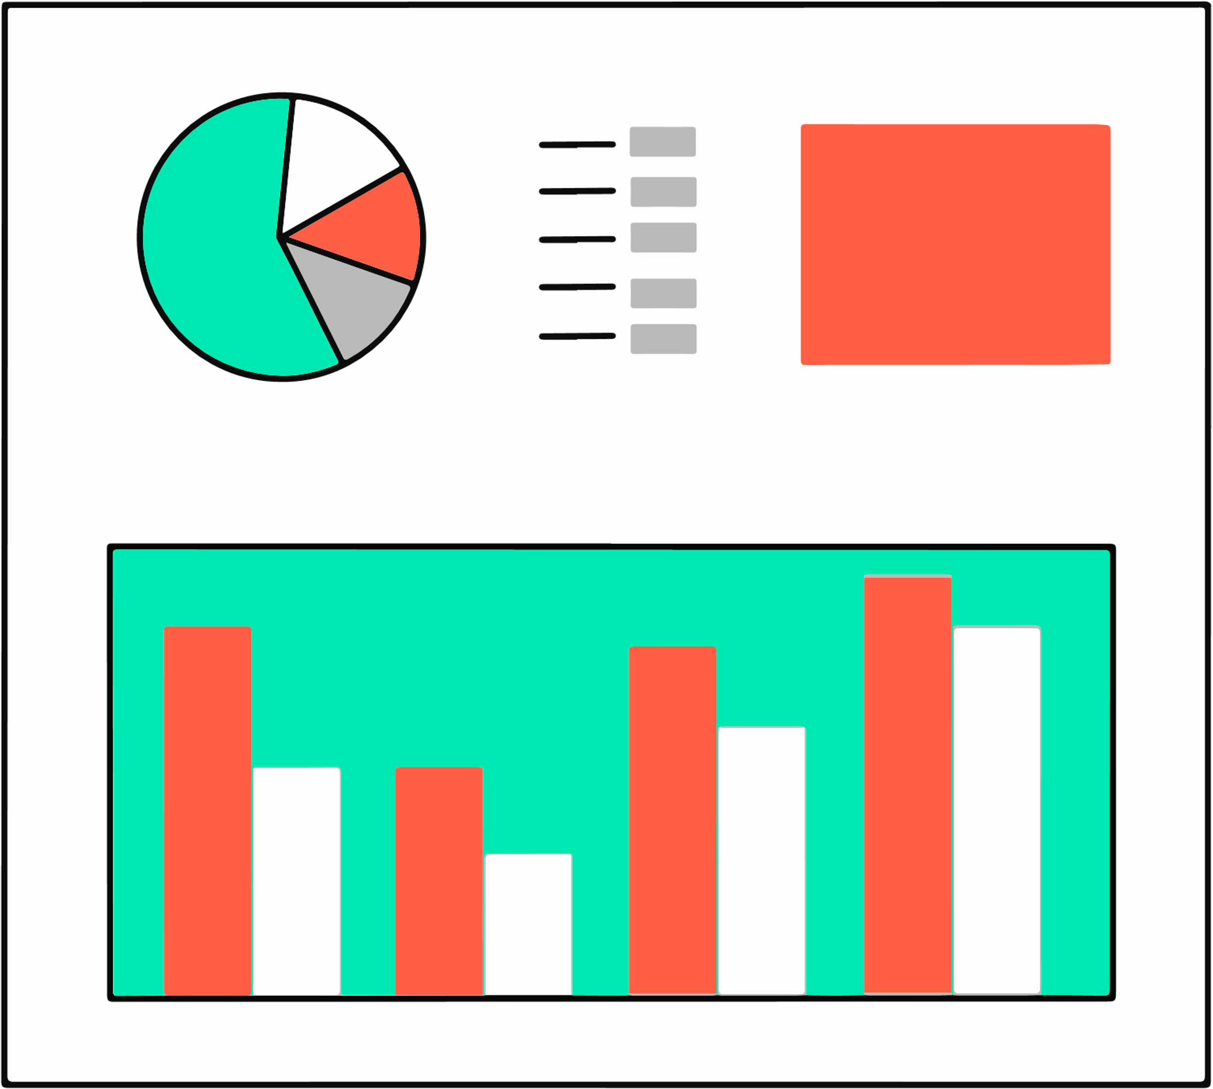



AGENDA
Understanding the diabetic landscape in Singapore
Process of Developing Predictive Models for Diabetes
Implications
from preliminary findings
Tsusha
Notes:
“Singapore is facing a serious diabetes challenge — one in nine Singaporeans already lives with diabetes, and this number could more than double by 2050. Despite existing screening tools, many high-risk individuals slip through undetected because current methods rely on limited data. Our project explores how advanced analytics can enhance diabetes prediction, supporting national efforts like Healthier SG to move from treatment to prevention.”

Slide 3
THE DIABETIC LANDSCAPE IN SINGAPORE

Slide 4
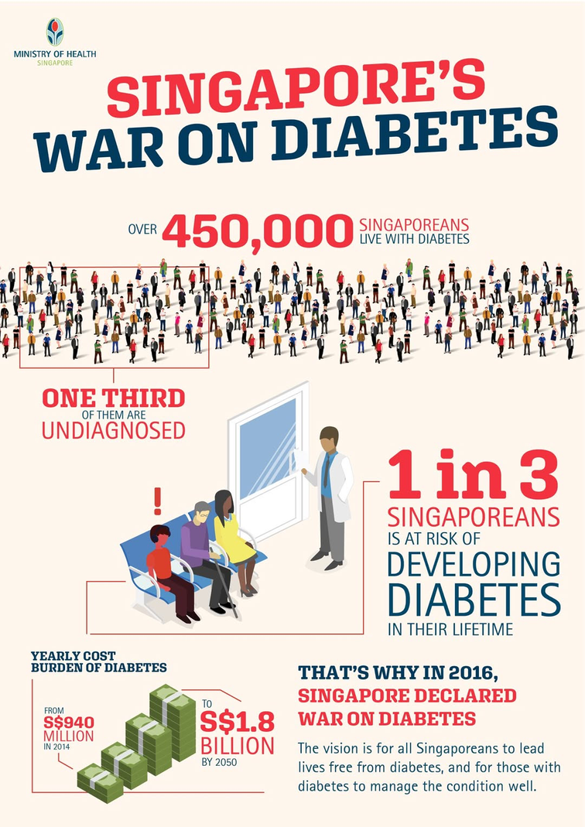
STATE OF DIABETES IN SINGAPORE
KEY STATISTICS, POPULATION IMPACT, EMERGING RISK DRIVERS
1
/
SINGAPOREANS
3
AT RISK OF DEVELOPING DIABETES IN THEIR LIFETIME
the “War on Diabetes” initiative underscored Singapore’s commitment to tackling chronic diseases such as type 2 diabetes.
IN 2016,
plans to transition healthcare system from a treatment-based approach to one focused on preventive care
IN 2023,
Tsusha
Notes:
“Singapore is facing a serious diabetes challenge — one in nine Singaporeans already lives with diabetes, and this number could more than double by 2050. Despite existing screening tools, many high-risk individuals slip through undetected because current methods rely on limited data. Our project explores how advanced analytics can enhance diabetes prediction, supporting national efforts like Healthier SG to move from treatment to prevention.”

Slide 5
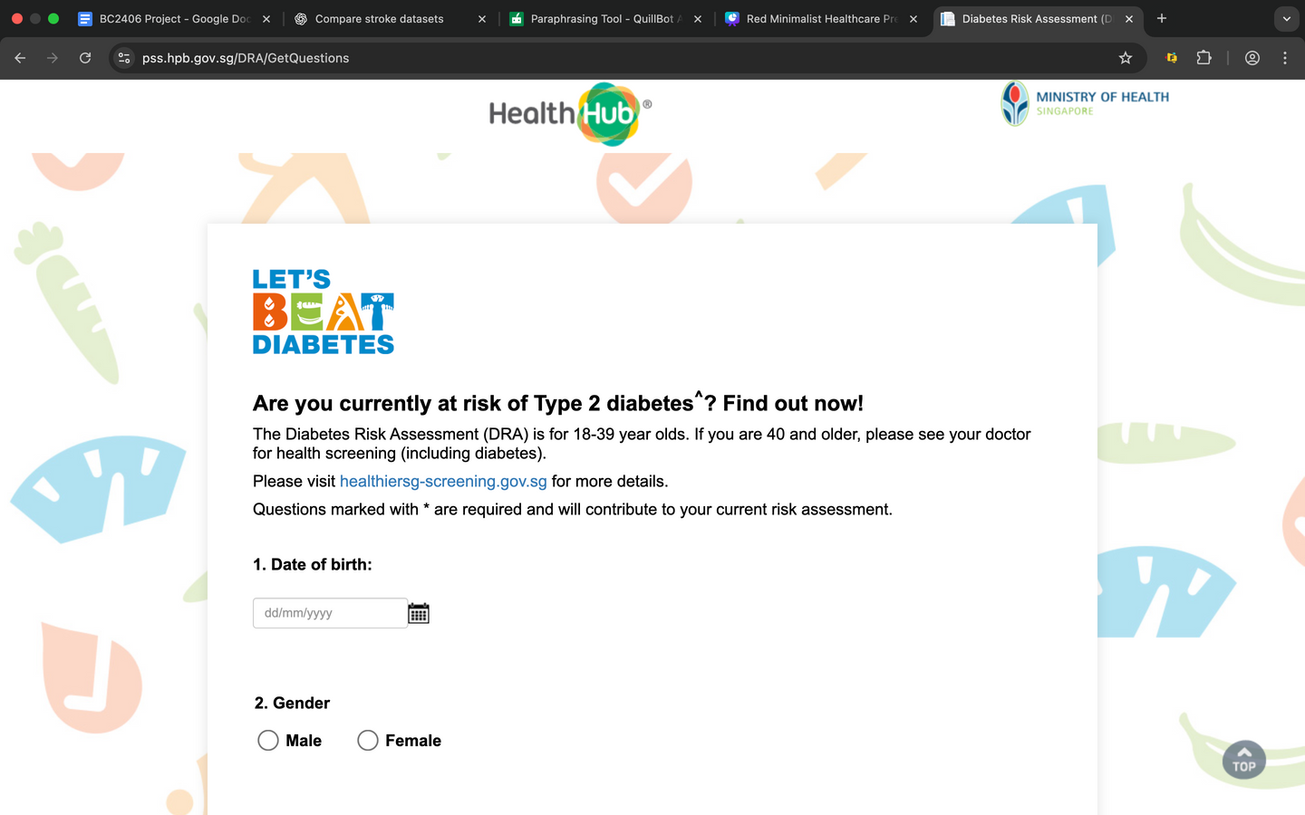
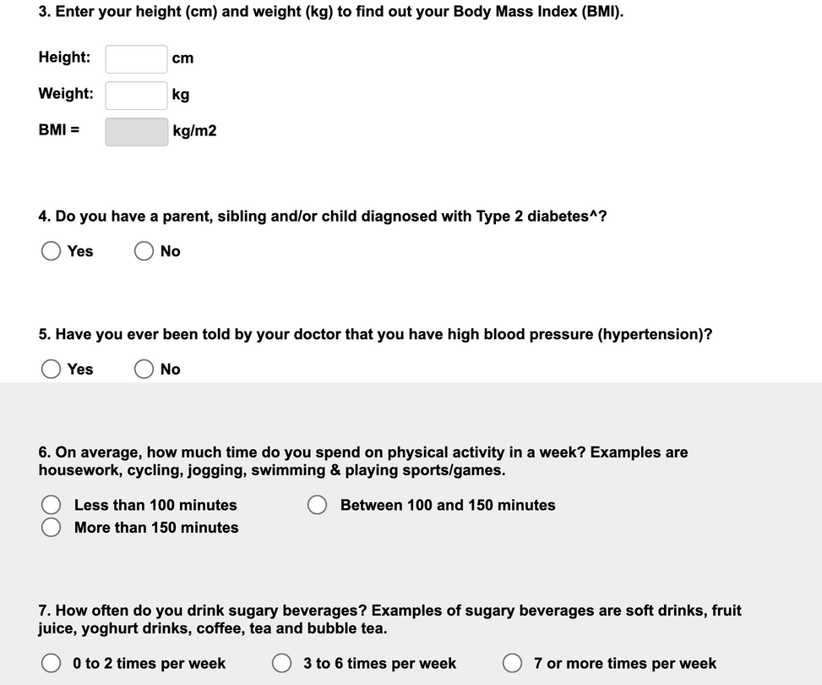
ADDRESSING THE DIABETES CARE GAP
WHERE PREVENTION CAN BE STRENGTHENED
Current screening tools (like the Diabetes Risk Assessment) have limited accuracy and rely heavily on self-reported data.
As a result, many at-risk individuals remain undiagnosed until later stages.
Tsusha
Notes:
“Singapore is facing a serious diabetes challenge — one in nine Singaporeans already lives with diabetes, and this number could more than double by 2050. Despite existing screening tools, many high-risk individuals slip through undetected because current methods rely on limited data. Our project explores how advanced analytics can enhance diabetes prediction, supporting national efforts like Healthier SG to move from treatment to prevention.”

Slide 6


DEFINING THE PROBLEM
NEED FOR A ROBUST DETECTION METHOD OF EARLY INTERVENTION
To develop a predictive machine learning model to assist medical professionals in identifying patients at high risk for diabetes.
Goal 1
Goal 2
Rising diabetes rates place growing pressure on healthcare resources. Early prevention through an accessible yet precise method necessary.
The model will integrate clinical indicators (e.g., blood glucose, HbA1c), along with demographic and lifestyle-related factors.
Dhruv

Slide 7
PREDICTIVE MODELS
FOR DIABETES AS
PROOF-OF CONCEPT
Dhruv

Slide 8

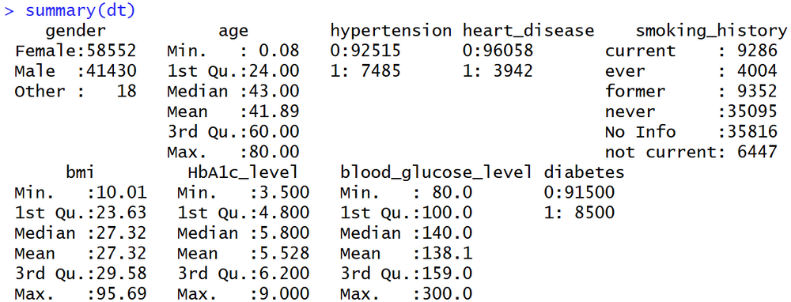
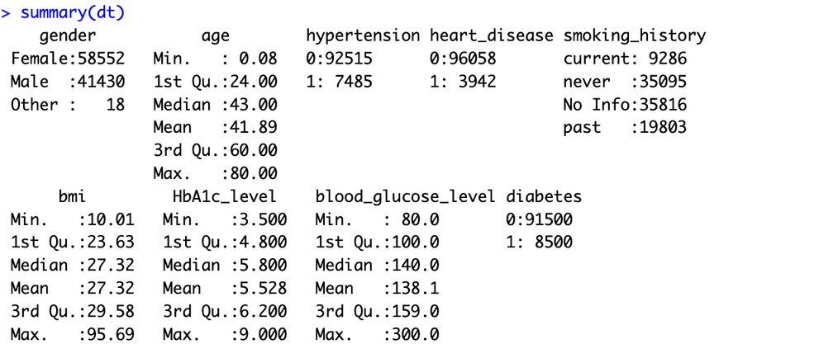
OVERVIEW OF DATASET
UNDERSTANDING THE DATA POINTS
*Under smoking history:
“ever”, “former”, “not current” were reclassified to “past”
Variable | Description
Gender | Three categories: male, female, other
Age, BMI, HbA1c, blood glucose level | Numerical variables
Hypertension, heart disease, diabetes | “0” represents patients without the disease “1” represents patients diagnosed with the disease
Smoking history* | Categorical variables
Jun Hao

Slide 9
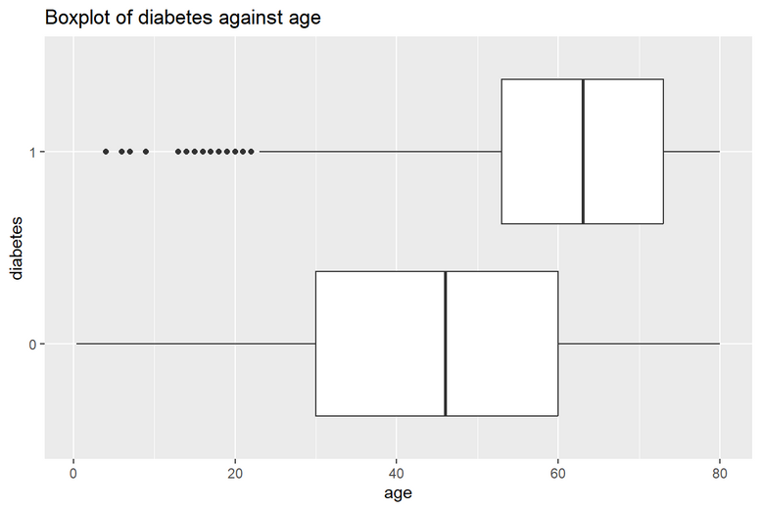
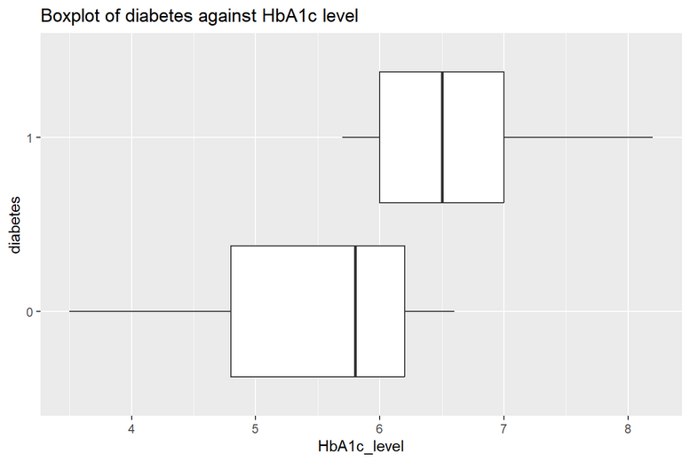
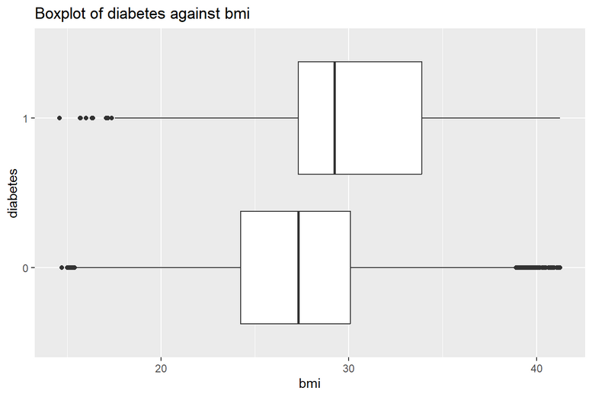
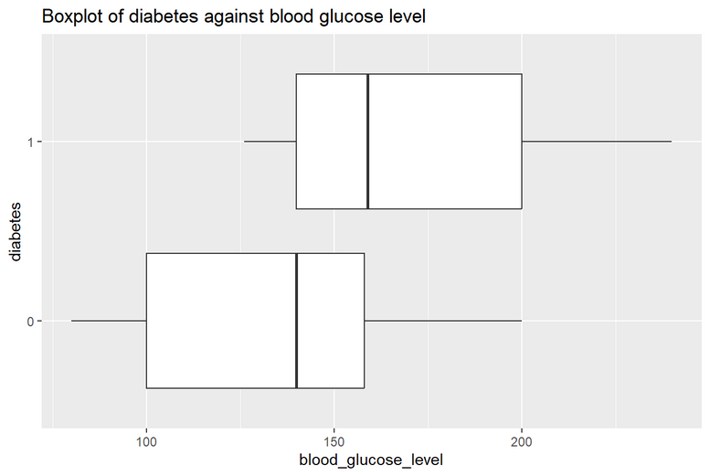
UNIVARIATE ANALYSIS
STRONG ASSOCIATION OF PREDICTORS WITH DIABETES
Age & diabetes:
Diabetes risk increases with age; only rare cases occur in younger people
HbA1c, blood glucose level & diabetes:
Elevated levels strongly correlate with diabetes incidence
BMI & diabetes:
Higher BMI is strongly associated with greater diabetes risk
Jun Hao

Slide 10
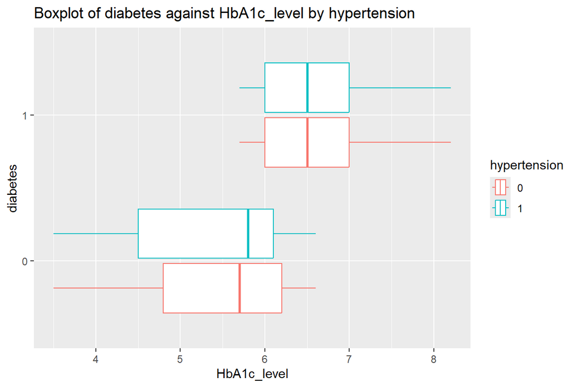
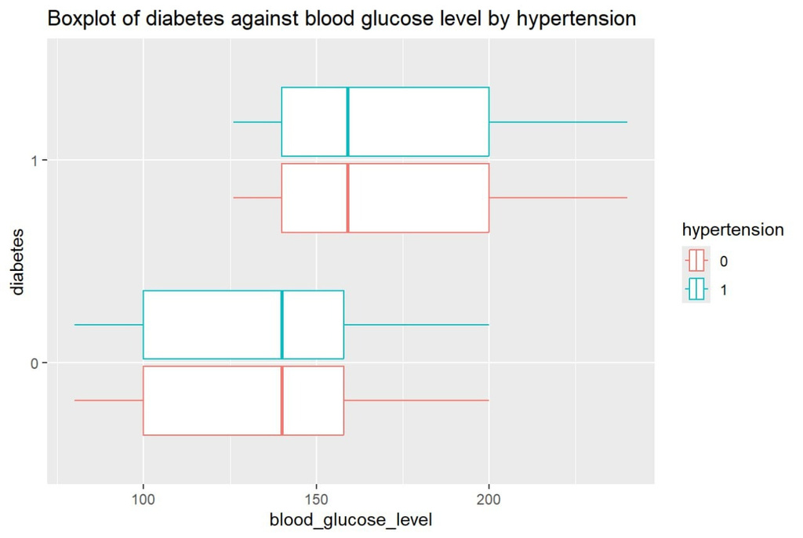
BI- AND MULTIVARIATE ANALYSIS
HYPERTENSION HAS LOW ASSOCIATION WITH DIABETES
Regardless of whether the patient was diagnosed with hypertension, diabetes status, HbA1c, and blood glucose levels did not differ
Hypertension appears to have no observed association with diabetes
Jun Hao

Slide 11





DATA CLEANING AND PREPARATION
DATASET INTEGRITY FOR RELIABLE MODEL DEVELOPMENT
Missing Value
Duplicate Value
Outlier
Data Balance
No missing data. However, ambiguous entries (i.e. no info) were removed
With no unique ID, 1103 duplicate records were removed
Values outside the Interquartile Range were removed as outlier
Sampling of non-diabetic data to address data imbalance
Jun Hao

Slide 12
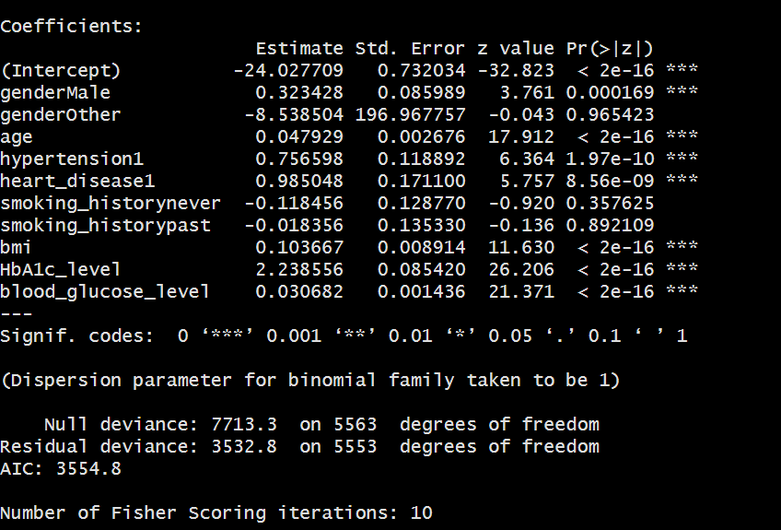
LOGISTIC MODEL
UNDERSTANDING MODEL PARAMETERS
70% of data was used to train this model
Useful interpretations from statistically significant variables
Values with asterisks (*) represents statistically significant variables, identified as important for predicting diabetic risk
Sean

Slide 13
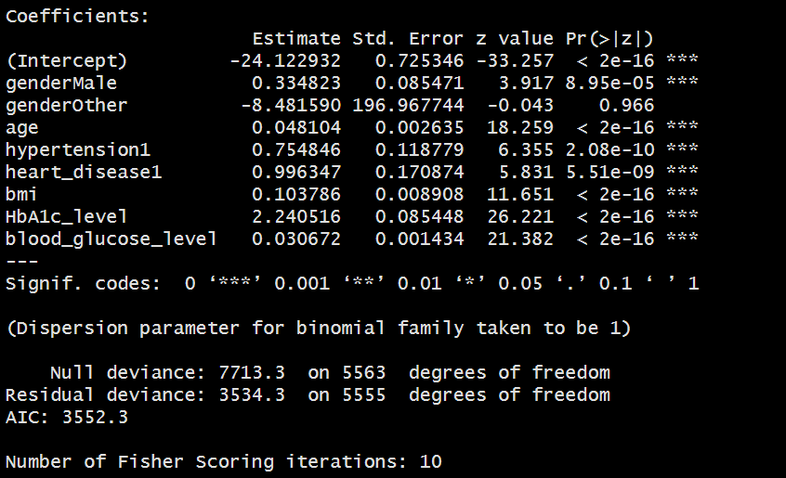
LOGISTIC MODEL: RESULTS
HEALTH INDICATORS ALIGN WITH MEDICAL KNOWLEDGE
Gender
Males have a 1.4x higher odds than females
Underlying conditions
Those with hypertension and heart disease are more susceptible
Age
1 year older increases odds by 4.9%
BMI
1 unit increase increases odds by 1.11 times
Glucose indicators
1% increase in HbA1c levels results in 9.49-fold increase in odds
1mg/dL increase in glucose levels results in 3.11% increase in odds
MONITORING THESE INDICATORS HELP EARLY DETECTION AND INTERVENTION!
Sean

Slide 14
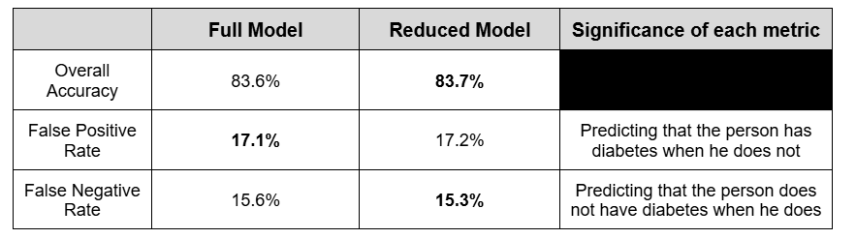
LOGISTIC MODEL: EVALUATION
MODEL WITHOUT SMOKING HISTORY PERFORMED BETTER
Reduced Model preferred due to higher overall accuracy and lower false negative rate
Reducing the false negative rate should be a additional priority
Sean

Slide 15
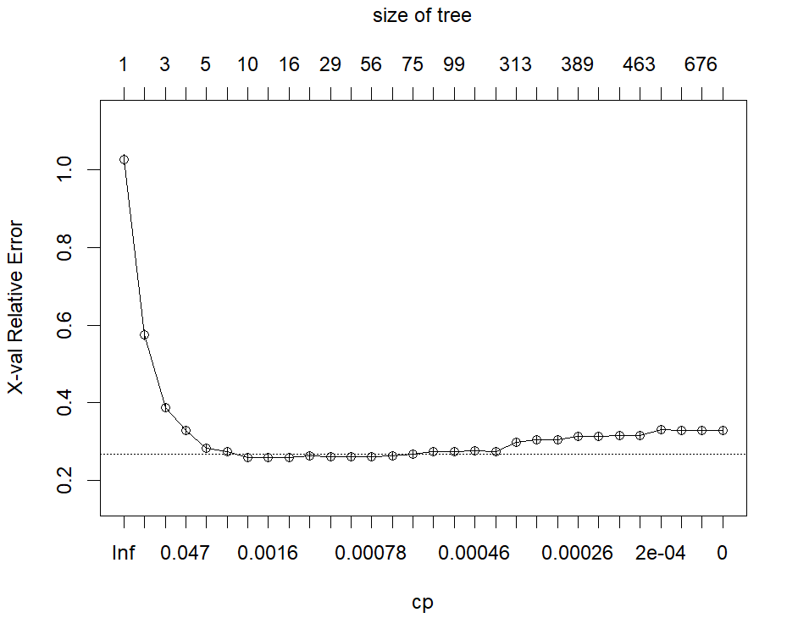
CART MODEL
UNDERSTANDING MODEL PARAMETERS
70% of data was used to train this model
Useful interpretations from statistically significant variables
Optimal Model
=
Lowest complexity
+
Relative Error below Threshold
Sean

Slide 16
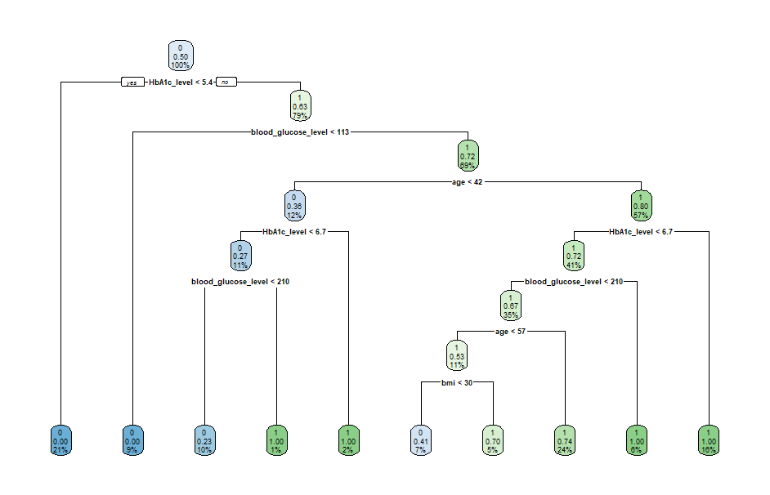
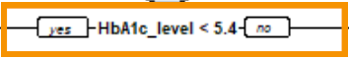
CART MODEL: RESULTS
HBA1C IS THE MOST IMPORTANT VARIABLE
10 terminal nodes
= 9 decisions made
If HbA1c < 5.4%, it is unlikely to develop diabetes
Blood glucose levels, age and BMI are significant in this model
Heart Disease and Hypertension NOT considered in this model
Sean

Slide 17
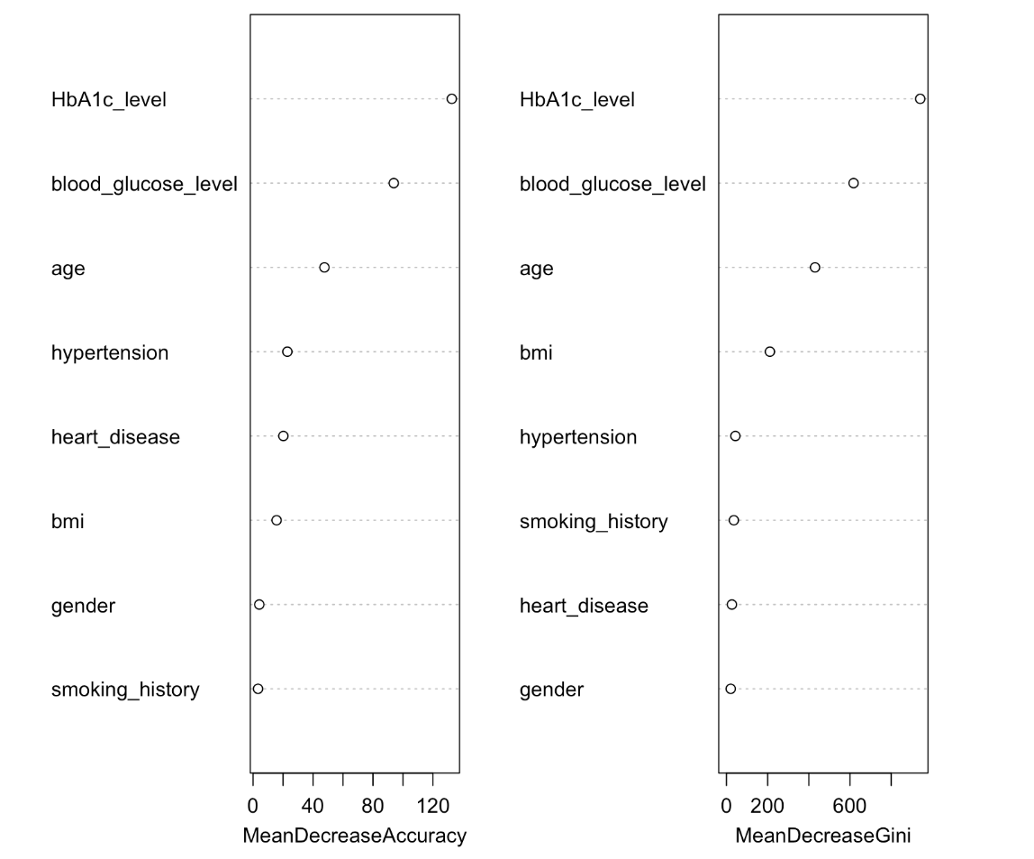

RANDOM FOREST
HBA1C AND GLUCOSE LEVELS HAVE HIGHEST IMPORTANCE
Mean Decrease Accuracy
Reduction in model performance when a variable is removed
Mean decrease Gini
Reduction in node impurity contribute by each variable
HbA1c and glucose levels have the highest importance, followed by age and BMI
Nikitha

Slide 18
MODEL COMPARISONS
RANDOM FOREST PERFORMS THE BEST
 | Logistic Regression | CART | Random Forest
Overall Accuracy | 83.70% | 86.30% | 87.50%
False Positive Rate | 17.20% | 11.60% | 10.60%
False Negative Rate | 15.30% | 15.60% | 14.00%
Model Insights | Top predictors: HbA1c, Age, BMI, Glucose, Blood Pressure, Heart Disease | HbA1c most important variable, Glucose, Age, BMI secondary | HbA1c, Glucose, Age, BMI, Hypertension — strongest overall predictors
1. Highest Accuracy
Random Forest achieved the highest accuracy at 87.5%, outperforming other models.
2. Lowest Rate of False Negatives
Random Forest had the lowest rate of incorrect predictions, making it the most reliable for practical deployment.
Nikitha

Slide 19
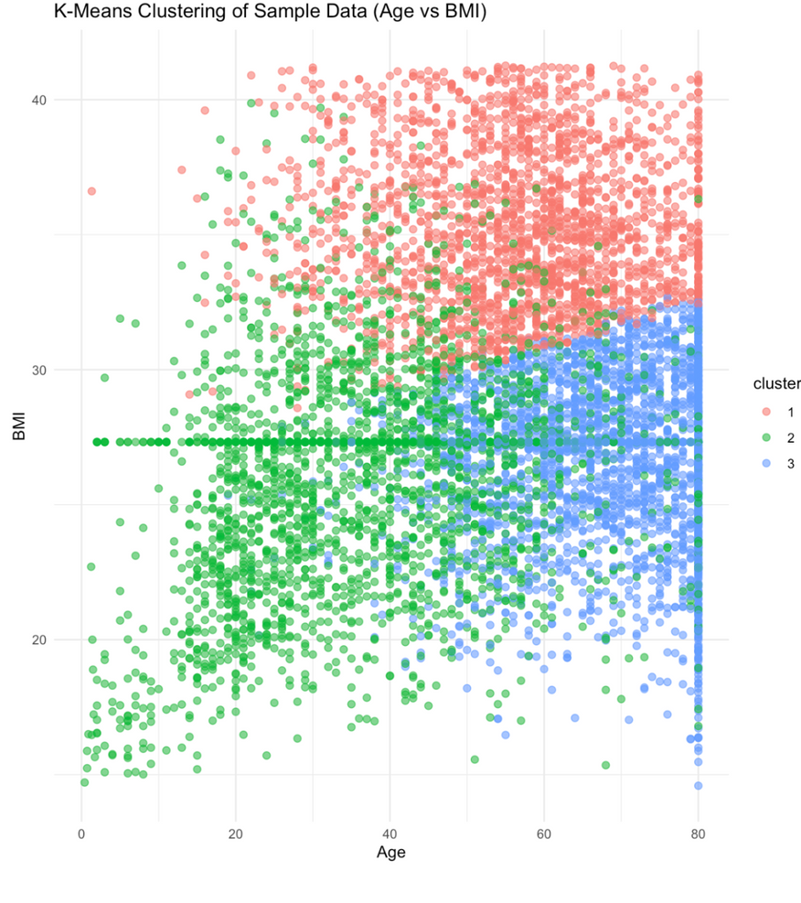
CLUSTERING
VALIDATE RESULTS FROM PREVIOUS MODELS
Group individuals based on similarities in key health metrics: Age, BMI, HbA1c, Blood Glucose levels
3 Clusters identified
Clusters 1 and 3:
Higher BMI and HbA1c indicate high-risk groups more prone to diabetes
Cluster 2
Lower BMI and HbA1c identified as the low-risk group
Nikitha

Slide 20
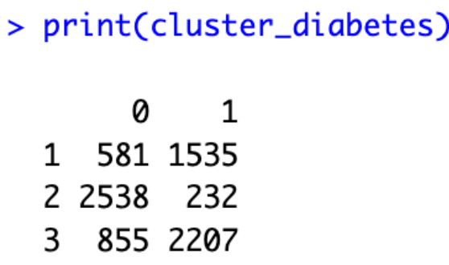
CLUSTERING: EVALUATION
USEFUL FOR DISCOVERY HIDDEN SUBGROUPS
Achieved ~78% accuracy in grouping individuals by diabetes risk.
Clusters 1 and 3 contained more diabetic cases, showing strong separation of high-risk groups.
While clustering doesn’t predict diabetes onset, it effectively flags populations needing closer monitoring.
Insights support targeted prevention and efficient resource allocation for public health planning.
Nikitha

Slide 21
IMPLICATIONS OF FINDINGS
—WHAT WE NEED FROM YOU

Slide 22
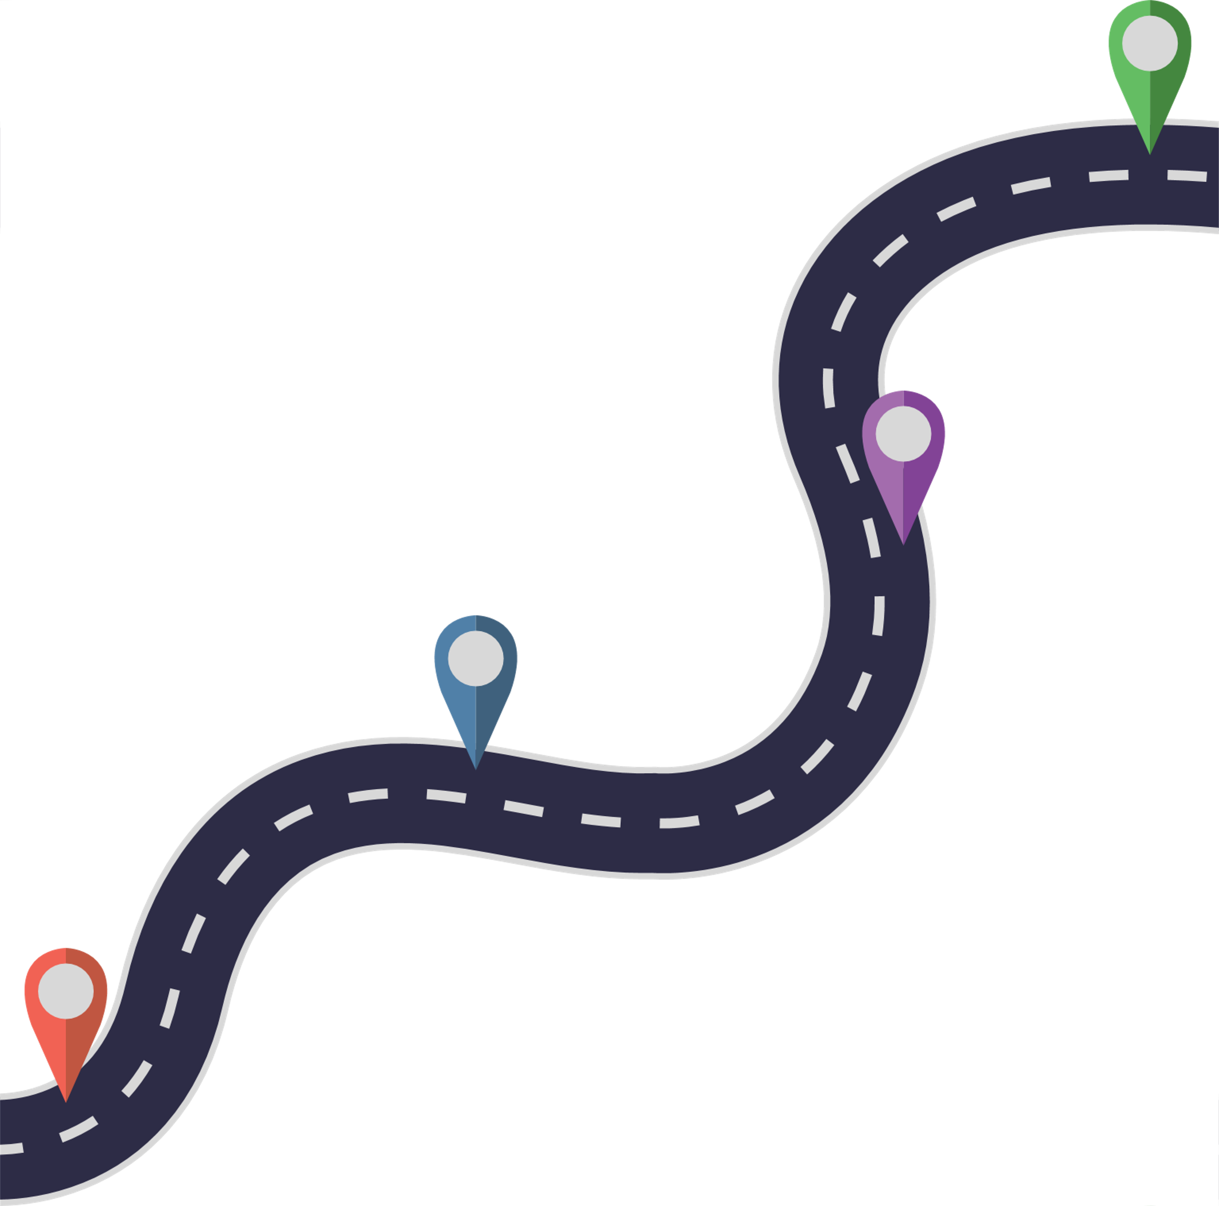

OUR PROPOSAL
Intervention
POSSIBLE MODEL DEPLOYMENT IN HEALTHCARE SETTING
Random Forest Model : 87.5% accuracy, false positives of 10.6% and false negative 14.0%
Integration into Singapore’s healthcare system requires:
Simplification of results for non technical users
Personalised diabetes risk scores highlighting key risk factors
Identification of high risk patients for timely interventions
Our model will undergo continuous model retraining with updated population data
Lastly we look to work together with MOH and SingHealth
Risk Score
Data inputed into model
Sidharth

Slide 23
STRENGTHS AND LIMITATIONS
KEY CONSIDERATIONS FOR NATION-WIDE DEPLOYMENT
Strengths | Limitations
Outperforms DRA (87.5% V 60%) | Trained on 1% of SG population
Effectively uses important clinical features | Incomplete clinical variables
Better than linear models | Lack of external validation and possible demographic bias
Sidharth
Sidharth

Slide 24
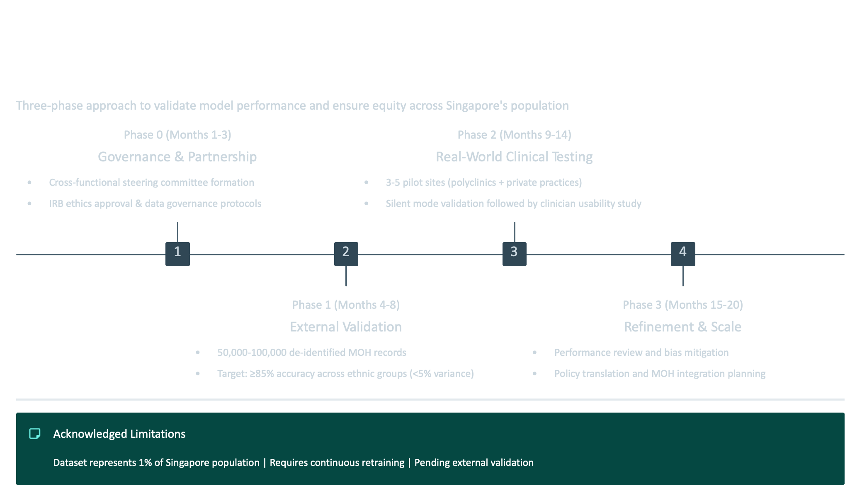
PROJECT TIMELINE
KEY MILESTONES AND DELIVERABLES
Dhruv
Notes:
PROJECT TIMELINE

Slide 25
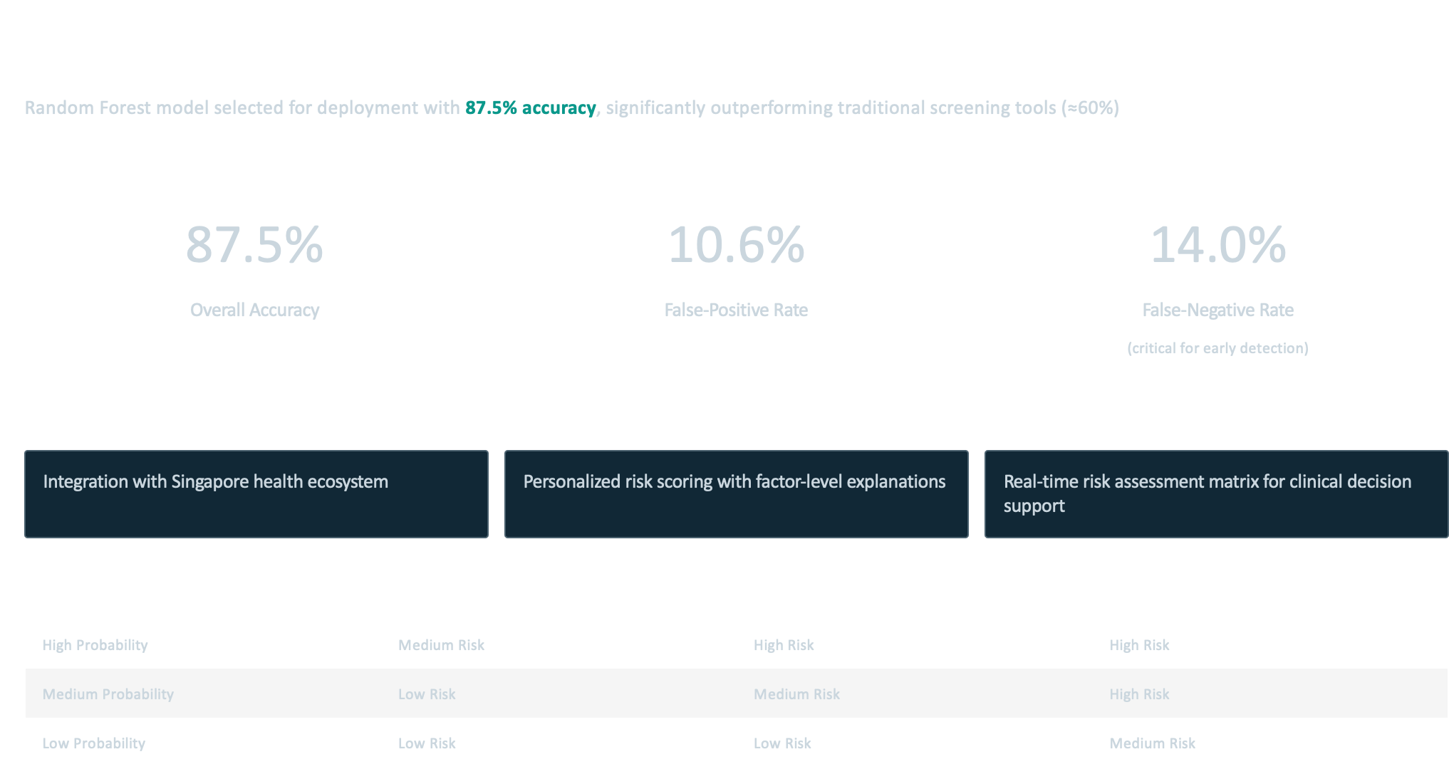
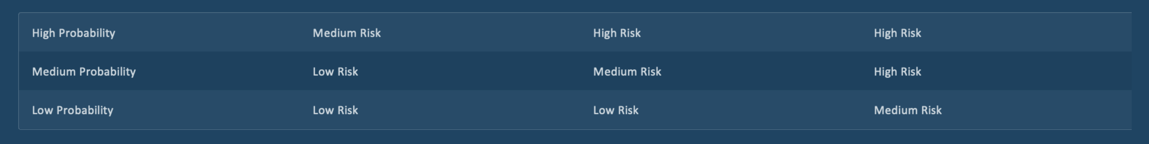
MEASURING SUCCESS
Key Performance metrics
87.5 %
OVERAL ACCURACY
10.6 %
False Positive Rate
14.0 %
False Negative Rate
Deployment Strategy
Integration with Singapore Health ecosystem
Personalized Risk Scoring With Factor level Explanations
Real Time Risk Assessment Matrix For Clinical decision Support
Risk Assessment Matrix
Dhruv

Slide 26
Project Achievements:
Achieved 87.5% accuracy with models including Logistic
Regression, CART, Random Forest, and Clustering.
Key predictors: HbA1c, blood glucose, BMI, age.
KEY FINDINGS AND FUTURE DIRECTIONS
Limitations:
Utilized a limited dataset from outside Singapore.
Needs a larger validation cohort for robust results.
Future Steps:
Plan to collaborate with MOH and SingHealth for more representative data and clinical testing.
Overall Impact:
This project presents a promising tool to support Singapore's diabetes reduction goals, enhancing early detection strategies
Dhruv
DHRU

